Slide 1
Meeting of AEMH and FEMS
Lisbon, June 9th 2018
Dr. Bernard Maillet
UEMS Treasurer

Slide 2
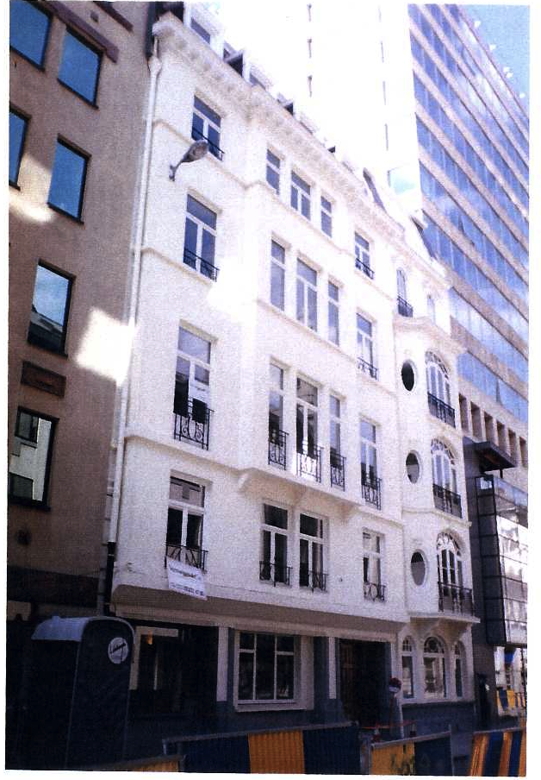
New Premises
European Domus Medica
Brussels, Rue de l’ Industrie 24

Slide 3
Outcomes of the last UEMS Council meetings
Marrakech April 2018
Dr. Bernard Maillet
UEMS Treasurer

Slide 4
Board Meeting
Friday April 27th 2018
Adoption of the Financial Situation for 2017
Adoption of the Amount for the Management fee for the UEMS bodies

Slide 5
Working Groups
Friday April 27th 2018
e-Health - Digitalization
CME – CPD
Post Graduate Training
Quality of Patient Care and Specialist Practice in Current Health Care systems

Slide 6
Meeting of the Groupings
Meeting of the Advisory Board
Friday April 27th 2018
Discussions about the topics related to the Sections on the agenda of the UEMS Council
Main topic :
  Management fee
  Distribution and repartition of the fee

Slide 7
Meeting of the UEMS Council
Saturday April 28t 2018
Secretary General’s report
Sections issues :
  ETR’s
    PRM Approved
    Endocrinology Approved
    Anestesiology Approved
    Gynaecology / Obstetrics Approved
    Emergency Medicine Approved
    Pediatric disciplines Approved

Slide 8
Constitutional Issues
Creation of an MJC in Adolescent Medicine
Change of name of the Section of Clinical Genetics to Medical Genetics
Honorary regulations in the RoP
Proposal to rename European Training Requirements to Recommendations
ETR reviewing process

Slide 9
Next UEMS Meetings
October 26th - 27th 2018 : Brussels
  60th Anniversary Ceremony and Council
November 23rd – 24th 2018 : CME Conference
April 12th – 13rd 2019 : UEMS Council (Location TBC)

Slide 10
Go raibh maith agaibh
Vielen Dank
Благодаря
Tak
Muito obrigado
Merci
Dekuji
Gracies
Dank U
сбасиво
Paldies
Tänas
Teşekkürler
Hvala
Thank you
شكرا جزيلا
Grazzi
Tack
Dakujem
Muchas gracias
Multumesc
Takk
תודה רבה
Grazie mille
ευχαριστώ
Faleminderit
Kiitos
Köszönöm
Dziękuję
Dėkoju

