Slide 1


FEMS General Assembly
Financial Reports
Bruxelles, 22 September 2018
    FEMS strategy, EU Health Policy, Conference on inequalities in doctors’ working conditions in the EU, Doctors' working conditions and remuneration across Europe, EWTD, Action Day 2018, Health Workforce, Medical Liability, Brexit, Professional Qualifications Directive, European Observatory of Medical Demography, National Reports

Slide 2
FEMS General Assembly
Financial Reports
Flowchart associated

Slide 3
FEMS General Assembly
Financial Reports

Slide 4
FEMS General Assembly
Financial Reports
Draft budget 2019

Slide 5
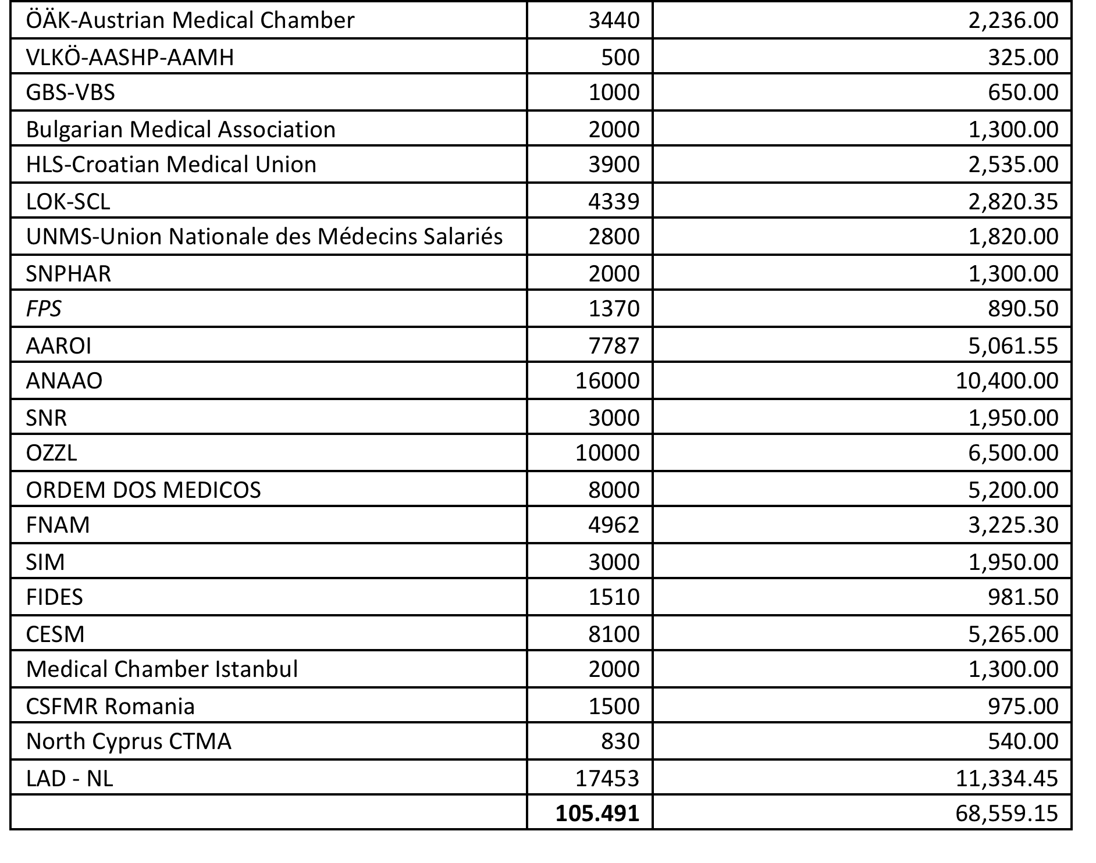
FEMS General Assembly
Draft Budget 2019
Declared Member
Membership fee 2018/2019: € 0.65

Slide 6
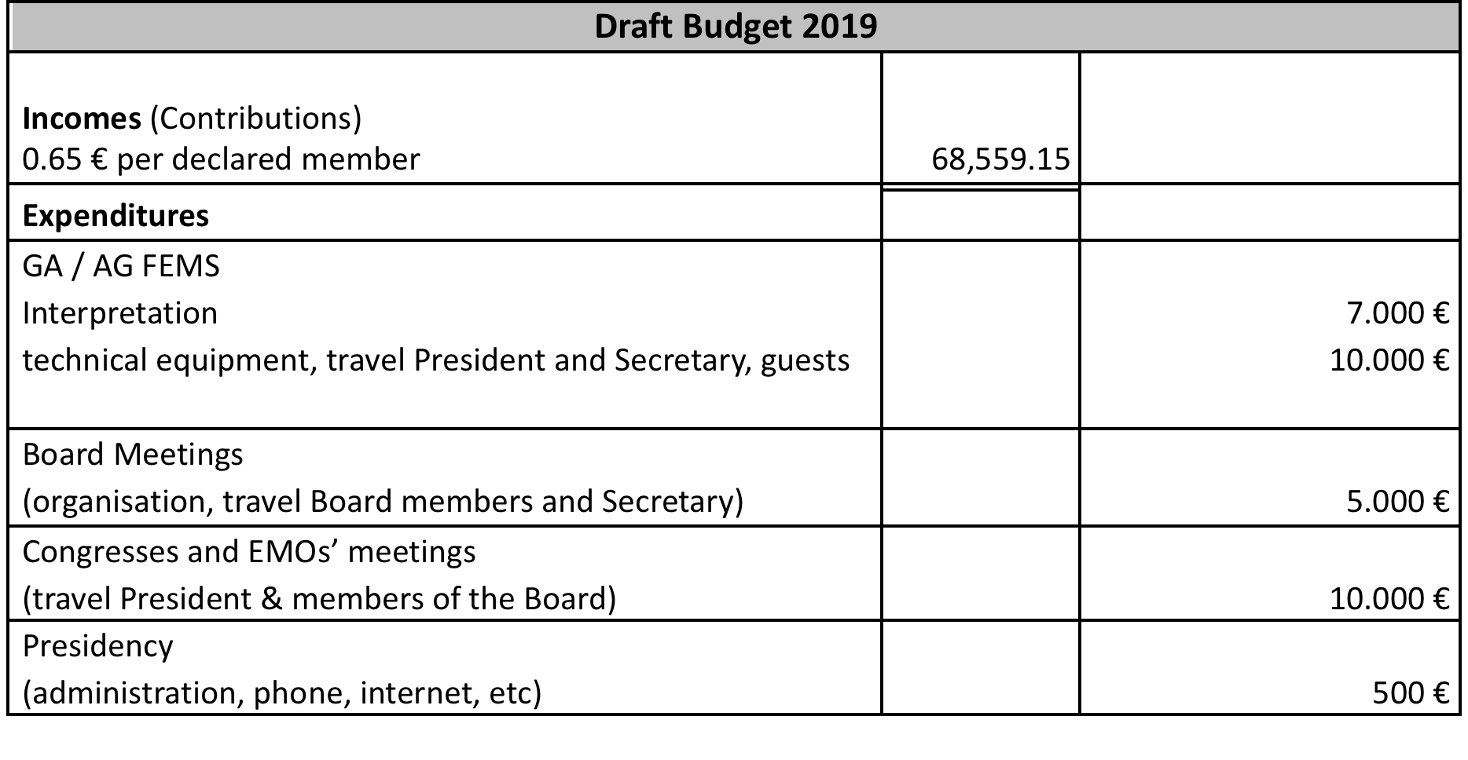
FEMS General Assembly
Draft Budget 2019

Slide 7
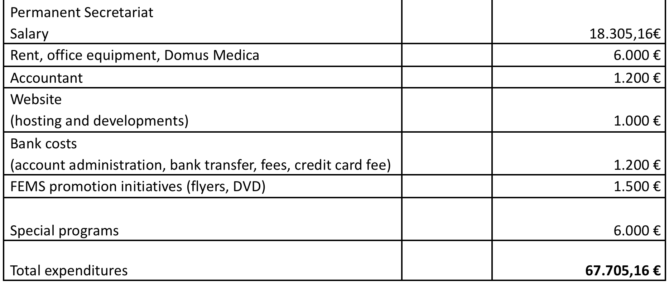
FEMS General Assembly
Draft Budget 2019

Slide 8

Obrigado

